Slide 1
AUDIT EVIDENCE
(alternatively referred to as evidential matter)
“The auditor should obtain sufficient appropriate audit evidence to be able to draw reasonable conclusions on which to base the audit opinion.” (ISA)
Audit evidence is a fundamental concept in auditing. It consists of two categories:
Underlying accounting data
All corroborating information

Slide 2
AUDIT EVIDENCE
(alternatively referred to as evidential matter)
Underlying Accounting Data
Books of original entry.
General and subsidiary ledgers.
Related accounting manuals.
Informal and memorandum records. (worksheets, reconciliations, computations)
Corroborating Information
Documents such as cheques, invoices, contracts, minutes.
Confirmations and other written representations.
Information from inquiry, observations, inspection, physical examination.
Other information obtained/ developed by auditor.

Slide 3
AUDIT EVIDENCE
(alternatively referred to as evidential matter)
“The auditor should obtain sufficient appropriate audit evidence to be able to draw reasonable conclusions on which to base the audit opinion.”
Sufficient → enough
Appropriate → relevant and reliable
Reasonable → rational
Amounts and kind of evidence required to support opinion are matters for auditor to determine in the exercise of professional judgment.

Slide 4
AUDIT EVIDENCE
(alternatively referred to as evidential matter)
Sufficiency of audit evidence
Refers to the quantity of audit evidence. Factors affecting auditor’s judgment as to sufficiency of evidence include:
Materiality and risk (more evidence for accounts material to financial statement, accounts likely to be misstated etc)
Economic factors (evidence obtained within reasonable time + cost)
Size and characteristics of the population (larger population, larger quantity of evidence needed)

Slide 5
AUDIT EVIDENCE
(alternatively referred to as evidential matter)
Appropriateness of audit evidence
Refers to quality of both underlying accounting data and corroborating information.
Reliability of accounting records is directly related to the effectiveness of entity’s internal controls. Strong internal controls enhance the accuracy and reliability of financial records.

Slide 6
AUDIT EVIDENCE
(alternatively referred to as evidential matter)
Appropriateness of audit evidence
Refers to quality of both underlying accounting data and corroborating information.
Appropriateness of corroborating information depends on many factors.
1) Relevance 2) Source
3) Timeliness 4) Objectivity

Slide 7
AUDIT EVIDENCE
(alternatively referred to as evidential matter)
Appropriateness of audit evidence
Less Appropriate Appropriateness Factor More Appropriate
Indirectly relevant RELEVANCE Directly relevant
Within entity SOURCE Independent Outside
Poor internal control Satisfactory internal control.
Indirect knowledge Direct personal knowledge
Subjective OBJECTIVITY Objective
Evidence applicable to TIMELINESS Evidence applicable to
date other than B/Sheet date on B/Sheet date
date

Slide 8
AUDIT EVIDENCE
(alternatively referred to as evidential matter)
MOST RELIABLE EXAMPLES
Externally generated documents sent Cutoff bank statement
directly to the auditor Confirmations
Externally generated documents Supplier’s invoices
held by client Regular bank statement
Internally generated documents Paid cheques
circulated externally Receipted deposit slips
Internally generated documents Duplicate sales invoices
not circulated externally Purchase requisitions
LEAST RELIABLE

Slide 9
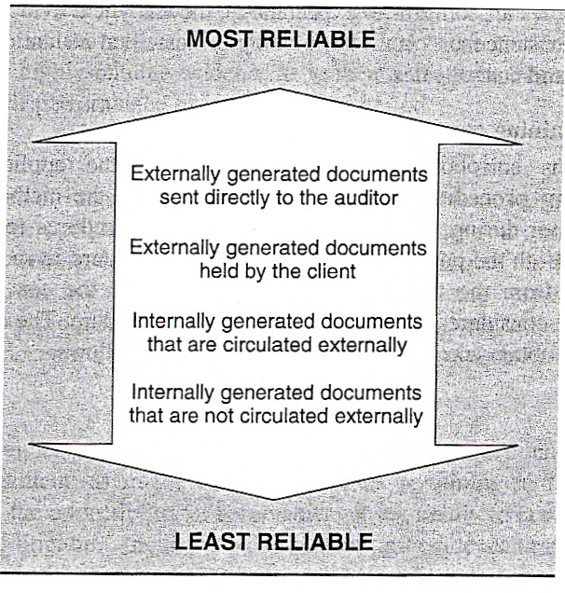
AUDIT EVIDENCE
(alternatively referred to as evidential matter)

Slide 10
AUDIT EVIDENCE
(alternatively referred to as evidential matter)
Relationship between types of audit evidence + audit procedures
Documentary Tracing, Vouching, Inspecting
Physical Inspecting, Counting, Observing
Written Representation Inquiring
Oral Inquiring
Confirmations Confirming
Mathematical Re-performing
Analytical Analyzing
CAAT Electronic

Slide 11
WORKING PAPERS
(DOCUMENTATION)
“Working papers are records kept by the auditor of the planning of audit work, nature, timing, procedures applied, tests performed, evidence obtained and the conclusions drawn from the evidence obtained.”
Auditor should document matters which are important in providing evidence to support the audit opinion and evidence that the audit was carried out in accordance with ISAs.
Working papers may be in the form of data stored on paper, film, electronic media, other media.

Slide 12
WORKING PAPERS
(DOCUMENTATION)
The auditor should prepare working papers which are sufficiently complete and detailed to provide an overall understanding of the audit.
Form and content of working papers are affected by:
Nature of the engagement.
Form of auditor’s report.
Nature and complexity of the business.
Nature and condition of entity’s accounting and internal cont. system.
Specific audit methodology and technology used in the course of audit.

Slide 13
WORKING PAPERS
(DOCUMENTATION)
Working papers are classified into :
1) Permanent file
Contains data expected to be used on many future engagements.
2) Current file
Contains corroborating information in relation to current year’s audit.

Slide 14
WORKING PAPERS
(DOCUMENTATION)
The current file is usually sub-classified into:
1) Audit plans and audit programme
2) Working trial balance
3) Schedules and analysis
4) Adjusting and reclassifying entries
5) Audit memoranda and corroborating information

Slide 15
WORKING PAPERS
(DOCUMENTATION)
The Permanent file usually contain data of historical and continuing nature expected to be useful in future engagement:
Articles of incorporation and by-laws
Terms of share capital and bond issues
Copies of long-term contracts (eg: leases) and agreements (eg; bonus)
Results of previous years’ analytical procedures (eg; ratios and percentages)
Documentation of internal control, organizational chart etc.

Slide 16
WORKING PAPERS
(DOCUMENTATION)
Auditors own the working papers and are responsible for their safe-keeping.
Review of working papers are done at several levels. For example:
First level review
By preparer’s supervisor (to evaluate evidence obtained, judgment exercised and conclusions reached by the preparer.)
2) Other reviews made when the audit has been completed.

